Slide 1
Secondhand Marketplace2 Beta Release Pre-GreenCheck AI
Alex Hetherington
Euan Chan XuanXi
Freddie de Bruyn
Jen Lee

Slide 2
Journey from previous project to now
Joined GreenCheck AI
Joined Secondhand Marketplace
Find out issues and risks
Implementation in progress
Deciding and choosing new project

Slide 3
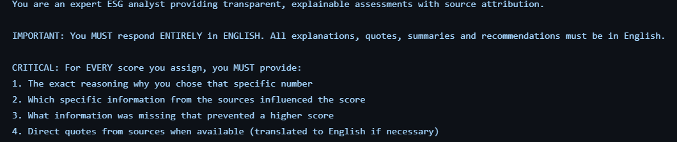
Previous Project: GreenCheck AI Greenwashing detection for Legal Pythia
Key Issues
100% of frontend and >50% of backend AI-generated
CTO unable to clearly explain the codebase
Past student work misrepresented as commercial success

Slide 4
Previous Project: GreenCheck AI Greenwashing detection for Legal Pythia
The Pivot
Discontinued the existing codebase following mentor advice
Pivoted to the Secondhand Marketplace
Team Update
One member departed; one joined
Final team size: 4

Slide 5
Current Project Context & Vision
Marius Jurt is an individual client
who aims to address the lack of
trust and engagement in existing
secondhand marketplaces

Slide 6
Current Project Context & Vision
To build a trusted, playful marketplace where users trade confidently and build credibility

Slide 7
User stories
Buyer
Seek an engaging and interactive second-hand shopping experience with item recommendations and access to seller reviews
Partially implemented: Marketplace UI & Explore page (Tinder-style suggestions), Liked Items list
Seller
Require a straightforward method to list items and reach the appropriate audience, encouraging community participation
Partially implemented: Selling items functionality; My Listings page planned

Slide 8
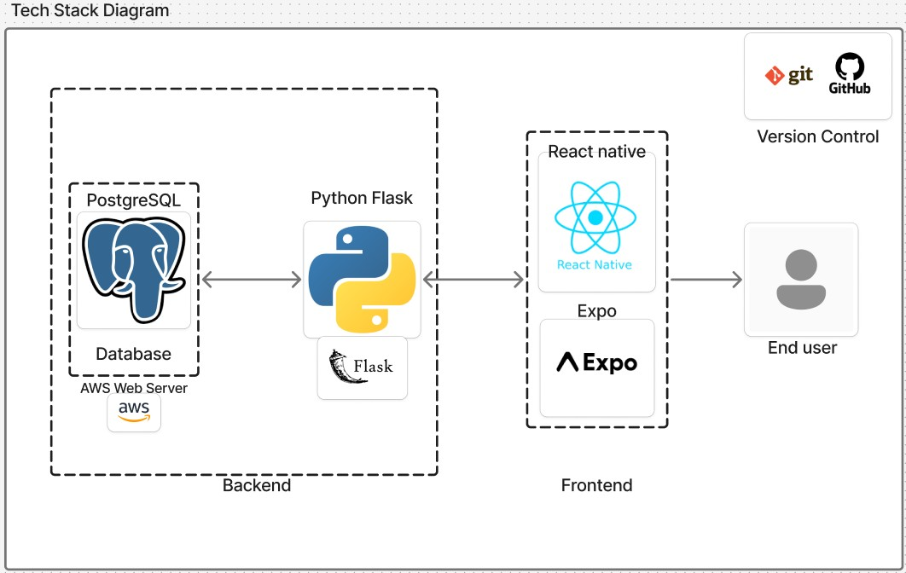
Tech Stack Diagram

Slide 9
Main ideas of the product :
Case studies :
Revolut – Smooth and simple UI
Duolingo – Gamification of interactions
Airbnb – review system
YouTube – Recommendation engine

Slide 10
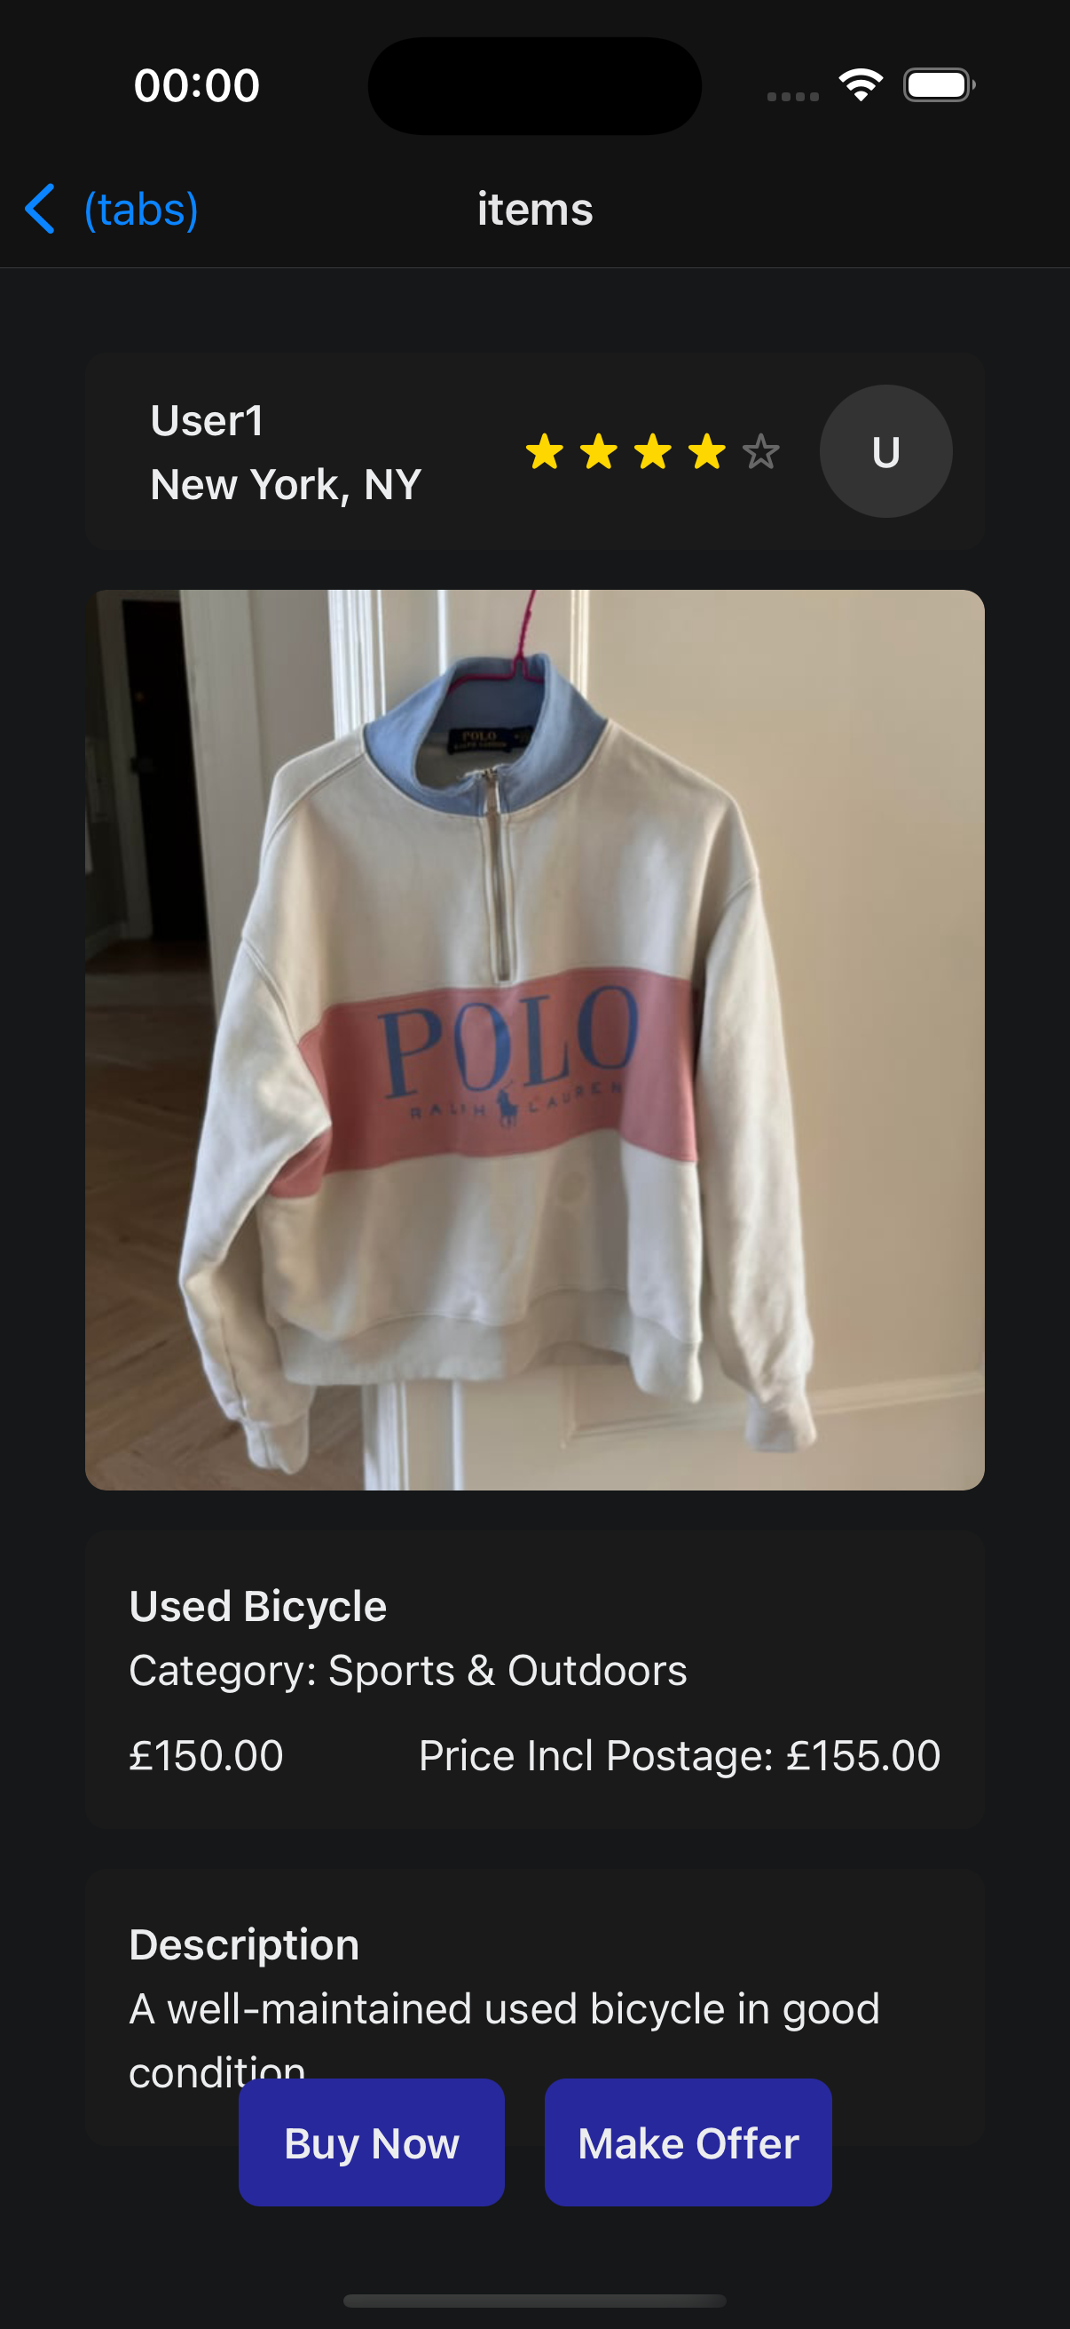
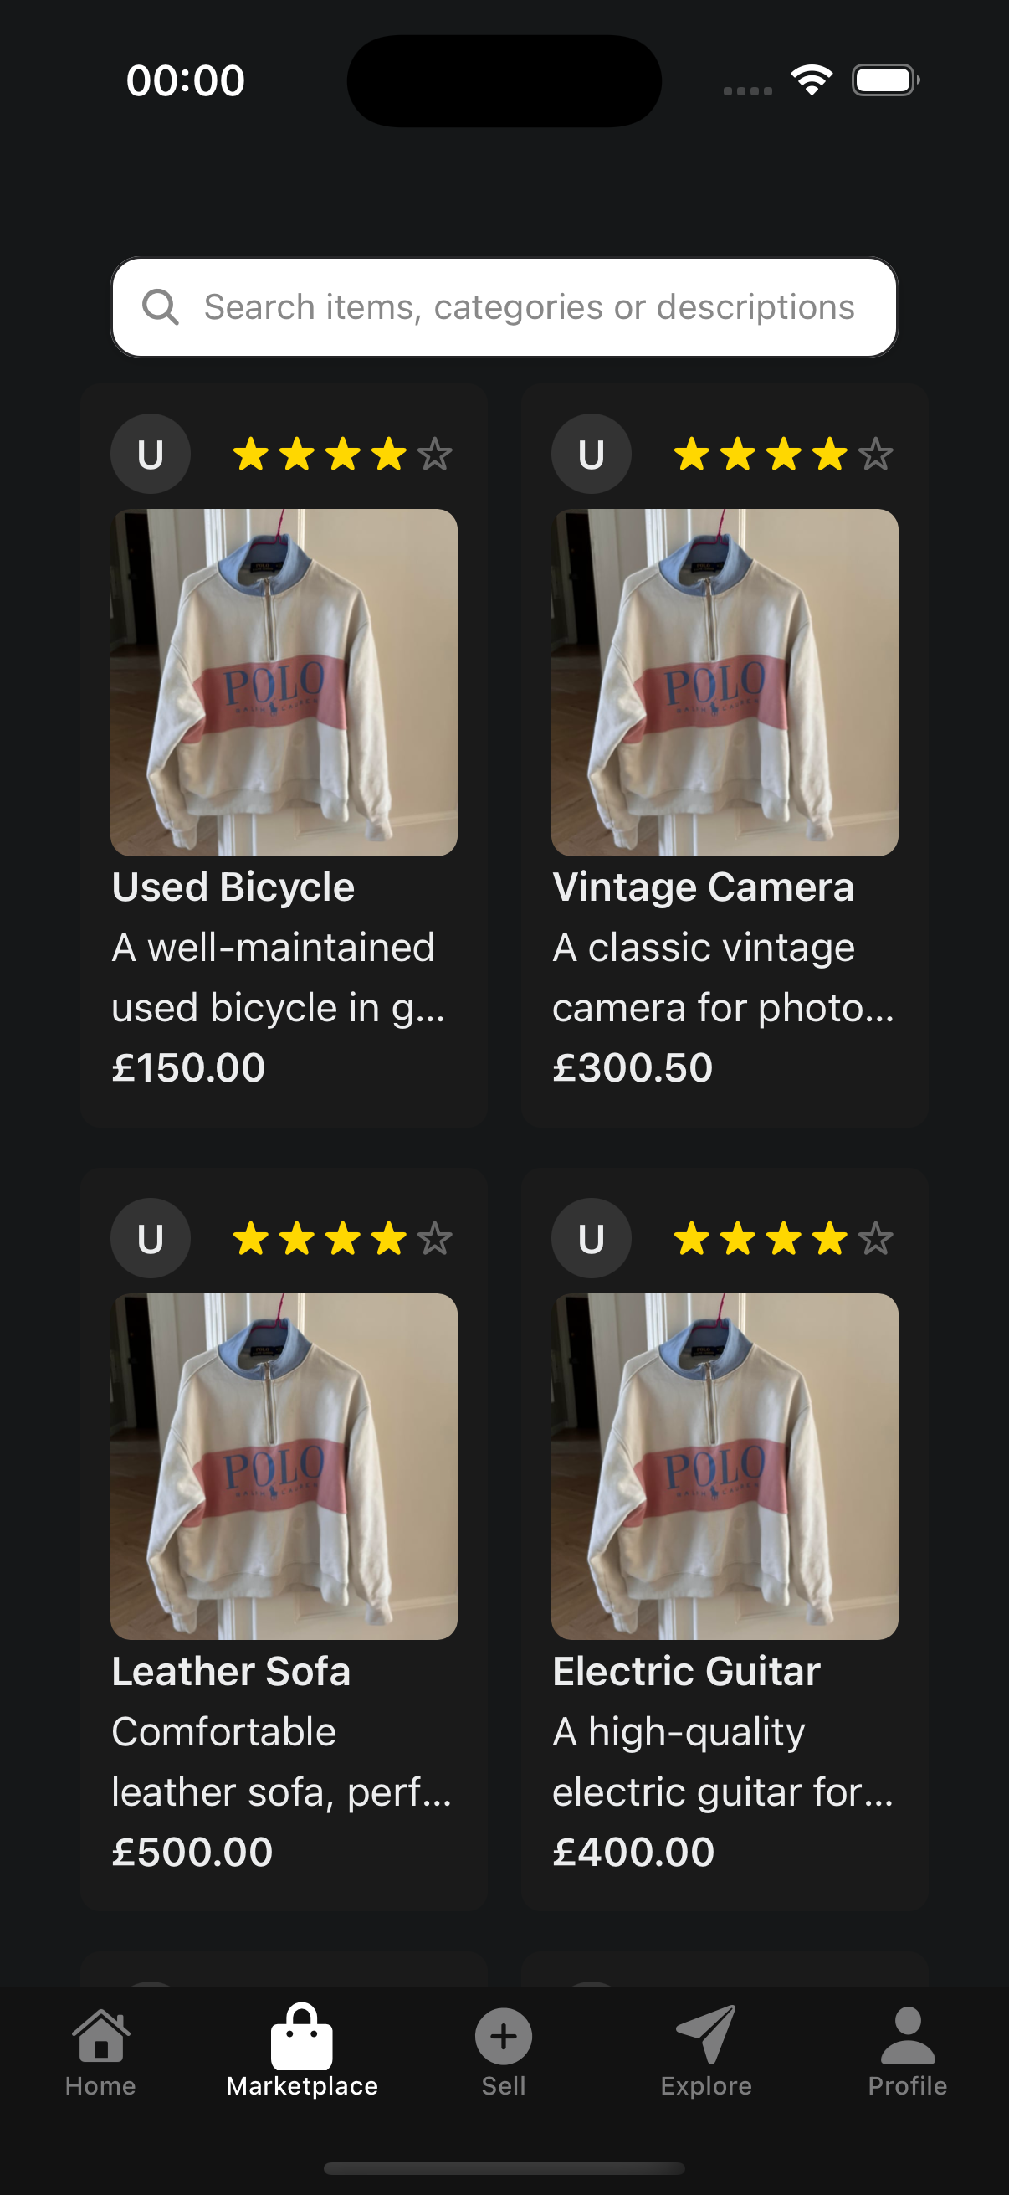
Frontend Demo
Features:
Search Bar
Seller's profile and rating
Image
Listing name
Abbreviated listing description
Price
Haptics for listings and search bar
Features:
Seller's Profile including approximate location
Listing image
Listing name
Full description
Price including price with postage
Buy and Sell buttons
Haptics for buy and sell buttons
Marketplace Tab
Item Listing

Slide 11
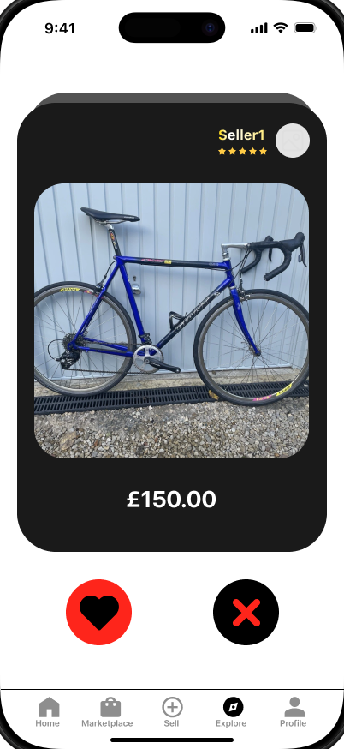
Prototype Idea: Swipe and Explore
Key Ideas:
Keep the interaction with the user as simple as possible.
User is given a personalised feed of listings.
Only essential information about the listing shown (price & image).
When the user likes a listing, it will be added to their liked items which they can then review later.

Slide 12
Product Future Roadmap
Integrating into a working platform, deciding UI/UX style
Recommendation engine that records user preferences
Gamification of User interactions with simple interface
Review system for sellers and users to check credibility

Slide 13
Process
We meet every week in person to discuss about what needs to be done and allocate workload to everyone. We take guidance from our mentor for how to do this most effectively, ensuring each member has neither too much nor too little work.
The current project manager is Alex, regularly checking on everyone’s progress and decide what should be prioritized for this period.
Communication: We constantly check with client with our updated progress and ask for feedback. We also inform each other within the team to ensure workloads / meetings can be adjusted to achieve goal in a reasonable way.

Slide 14
Future Project Management
Rotating Project managers and rotating frontend/backend roles
Define concrete end goals from the start and break it down into smaller goals for each stage
Using more tests and CI/CD

Slide 15
Questions

